Slide 1

ratonga taiohi pānui
what you need to know
Rāmere 16 Whiringa-ā-nuku 2025
Thursday 16 October 2025
Notes:
Add the date to each slide – check dates
Celebration days on front page
Arial 12 or 14
Titles and sub titles must be lower case
Check audio options for visually impaired
Keep icons on this draft page off to the side – so we can use for future updates
Coaches want to see and share:
Tips and tricks
Success stories
Resources
Funding opportunities and services that are available out of MSD
regional – led by RCM
national – signposted in YS Update

Slide 2


labour day changes to payments
changes need to be reported early, and taiohi paid on tuesdays will be paid early
The Labour Day public holiday is coming up on Monday 27 October, this day changes when affecting payments need to be reported by and some payment dates will be earlier.
Taiohi will need to report any changes that will affect their payments (for example, wages or bank account details) for the week of 27/10, so they are done by Thursday 23 October (usually this is on Fridays).
Taiohi who normally get paid on a Tuesday will be paid on Saturday 25 October. Make sure they understand that this is not a ‘bonus payment’.

Slide 3

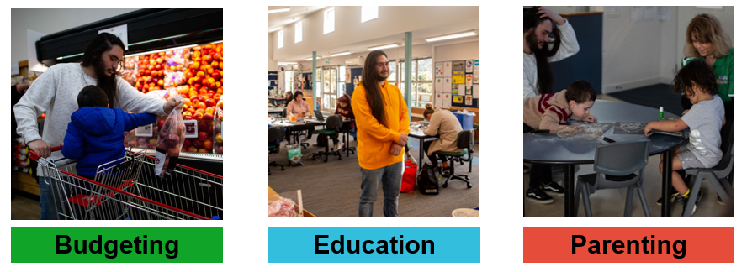
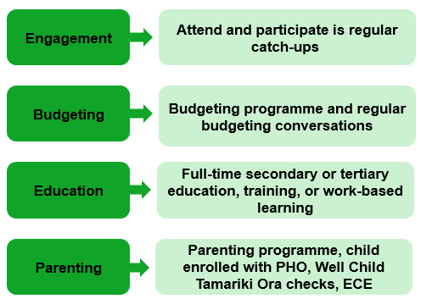
drop in recap: obligations and sanctions
16/10/2025
part one: what the obligations, incentives and exemptions are
obligations
Taiohi receiving Youth Payment or Young Parent Payment have benefit obligations – telling you about a change in their situation and youth activity obligations.
The youth activity obligations fall under four categories:
Learn more
meeting youth activity obligations | Youth Service providers
incentives
Taiohi can receive weekly $10 incentive payments for meeting their budgeting, education, and parenting obligations.
Learn more
incentive payments | Youth Service providers
exemptions
Taiohi can get an exemption for some or all of their obligations for a specified period of time.
We’ve recently updated the exemption task in ART with more information on non-medical exemptions – check it out in ART.
If the barrier to them meeting their obligation is a permanent condition, consider applying for Supported Living Payment.
Learn more
exemptions | Youth Service providers
Exemptions from activity obligations | Map
Supported Living Payment - Work and Income

Slide 4
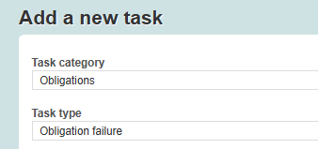
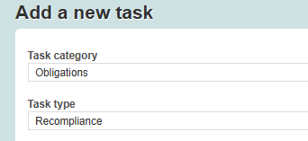
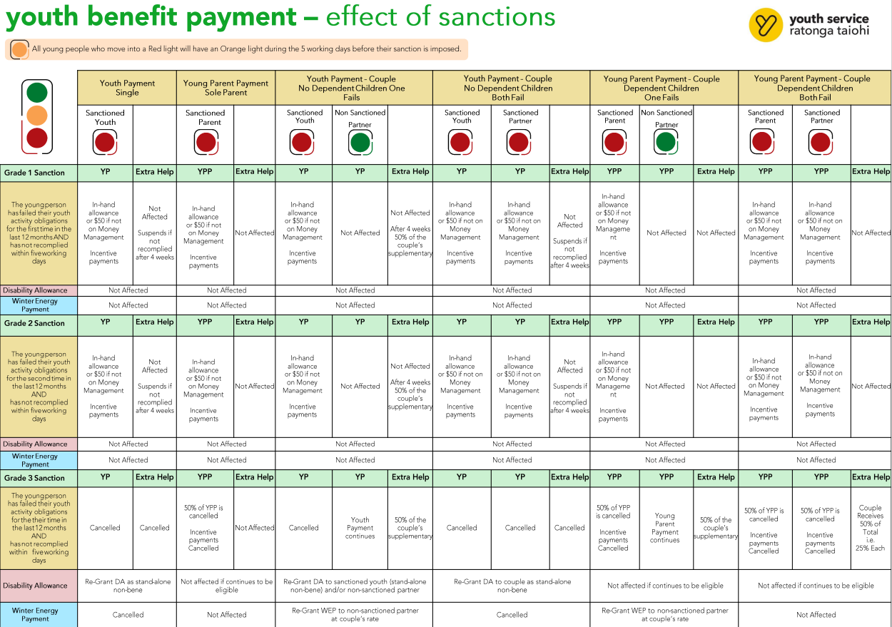
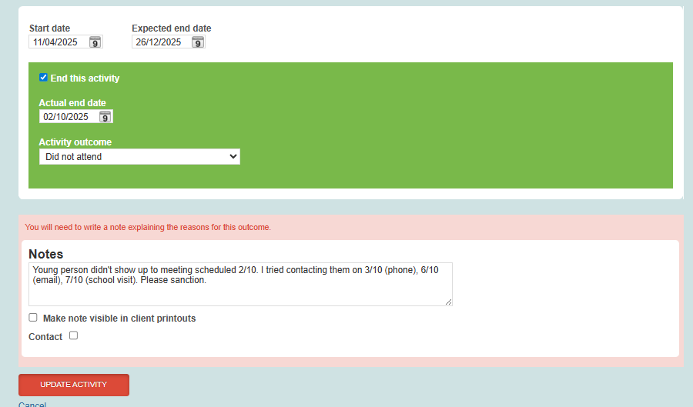
drop in recap: obligations and sanctions
16/10/2025
part one: failures, sanctions & grades and getting back on track
obligation failures
The big thing – new tasks!! New tasks Task category: obligations Task types: obligation failure & recompliance
Questions in tasks For smoother processing
Don’t close activities that aren’t 100% over Leave activities if you're not sure it has ended, and add good notes.
Learn more
For experts in the current process
obligation failure process change – the short version
For people who want more detail
obligation failures in art - youth activity obligations
sanctions and grades
Young people will have that on their record for a year. If they fail again within the 12 months, their next failure will be a grade 2, and their third within a year of that first failure, a grade 3.
Different grades mean different sanctions. Click on the table below to read more.
effect of sanction table | youth service providers
getting back on track
After an obligation failure task happens young people have a few paths to getting back on track. They can:
Go back to do the same activity as they failed
Do a similar activity
Tell you about a ‘good and sufficient’ reason they have for not doing the activity.
You’ll submit the *new* recompliance task and YSSU will process it.
Learn more Recompliance (Grade 1 and 2) - Map

Slide 5

upcoming drop-in sessions
16/10/2025
drop-in to meet other youth coaches and learn about youth service
programme fund
Tuesday 21 October, 10am
Programme Fund can be used to help taiohi pay for things that will improve their employability, education or wellbeing.
It’s for things that will help them reach their goals in their Youth Service plan that can’t be accessed through other payments, like hardships.
Bring examples of creative ways you’ve used the fund to inspire other coaches.
Join the teams meeting
yssu spotlight
Tuesday 4 November, 10am
Kaimahi from YSSU will lead this informative session filled with inside knowledge on things like:
how they approach tasks
application tips
change in circumstances, reviews, hardships
contacting them, and
more general tips and tricks.
Got a question already? Feel free to send it through to ystraining@msd.govt.nz.
Join the teams meeting
You can find the full drop-in session schedule on our provider site
drop-in sessions | Youth Service providers

Slide 6



realising the dreams and aspirations of youth
tau awhitia te taiohi, ka puta ki te wheiao
providers.youthservice.govt.nz
national_youthservice@msd.govt.nz

